Slide 1
Robot Operating System - ROS
AI in ROS

Slide 2

Introduction to neural networks
1
Recognition vs detection
2
3
AI in edge devices
Table of contents

Slide 3
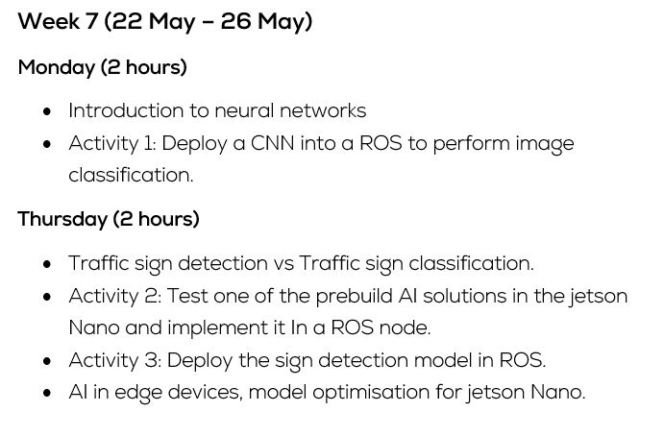
Schedule

Slide 4
Getting Started with ROS
Introduction to neural networks

Slide 5
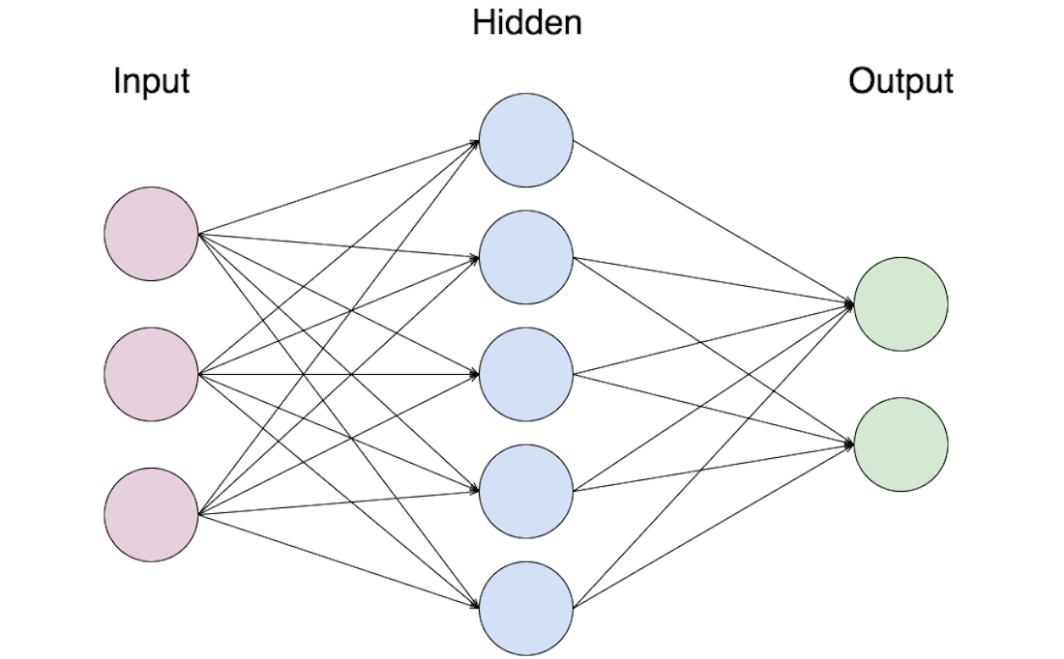
Introduction to neural networks What is a neural network?
Set of nodes (neurons) that take the information the user sends through the Input layer, apply some mathematical operations and send them back through the output layer.
Input layer
Neurons directly connected to the user input
Hidden layer
Neurons only connected to other neurons
Output layer
Neurons delivering the result

Slide 6
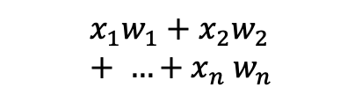
Introduction to neural networks What is a neuron?
Minimal element of a neural network, it takes as an input a weighted combination of numbers and outputs the result of applying a given function to it, known as activation function.
$$x_{1}w_{1}+x_{2}w_{2}+ …{+ x}_{n}w_{n}$$
Neuron with a sigmoid activation function

Slide 7
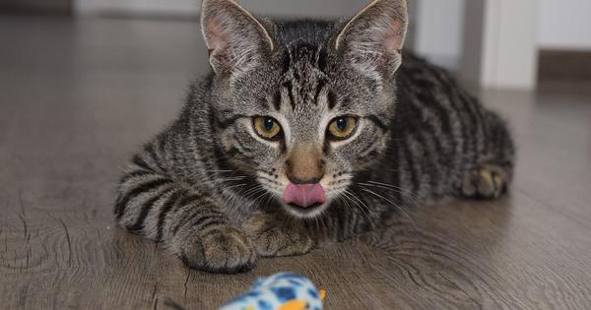
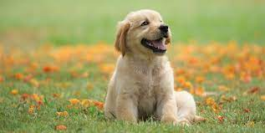
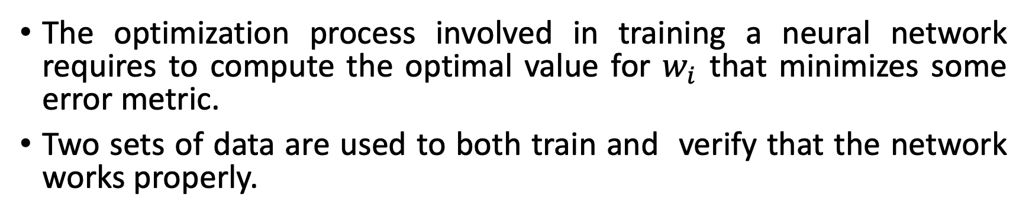
Introduction to neural networks How to set up a network?
The optimization process involved in training a neural network requires to compute the optimal value for $w_{i}$ that minimizes some error metric.
Two sets of data are used to both train and verify that the network works properly.
Database
Cat
Optimization
Dog

Slide 8
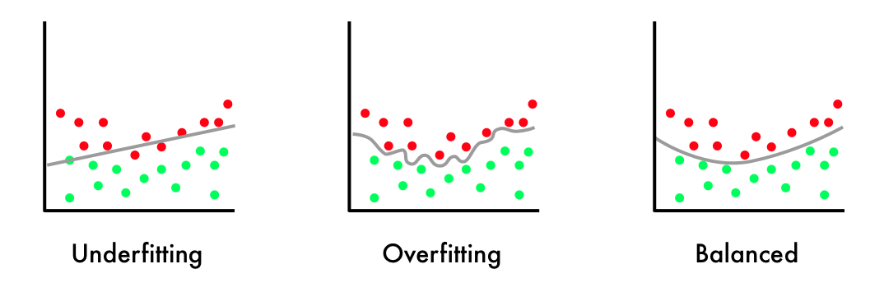
Introduction to neural networks Overfitting
When the network is too adapted to our data, we say it is overfitted.
This phenomena makes our network too stiff, it’s very good working with the data that we used to train it but it’s very bad with new samples, making in unusable in application.

Slide 9
Building an AI solution Generating a dataset
When picking a dataset all classes, for example cats and dogs when classifying animals, need to be equally represented to ensure that the network is not biased.
At the same time, we need to be sure that there are all types of dogs within the dataset to make the solution as general as possible.
Finally, the data should be normalized to reduce the influence of noise or artifacts in the data used in our application
Building a dataset pipeline
Capture Data
Problem
Resizing the images
Noise filtering
Grayscale image
Search
dataset
What do I need?
Preprocessing
Data acquisition

Slide 10
Building an AI solution Training a neural network
Training
Optimization
Yes
Training
Dataset
Network
Performance
metrics
Is it good
enough ?
Change dataset
Testing
Dataset
Network
No
Change architecture

Slide 11
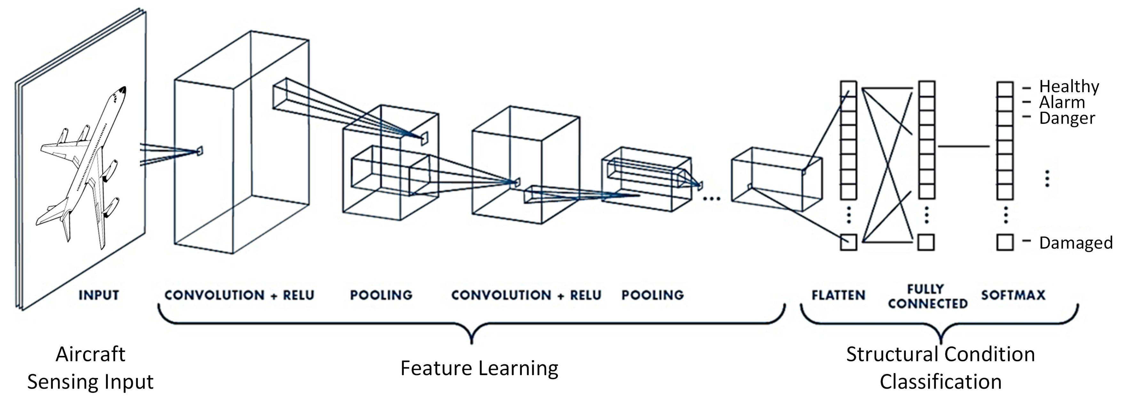
Shape Classification with AI Problem statement and proposed solution
The most common type of neural networks used with images are known as convolutional neural networks.
An image is going to be provided and the the extract some features and classify it.

Slide 12
Shape recognition with AI Preprocessing and regularization
In our example the original images are colored a and have different shapes, in order to process them we need to apply the following procedure.
Resizing the images to a common shape that matches the input of the network.
Apply histogram equalization to remove artifacts and reduce noise
Convert the data to grayscale
Normalize the data between 0 and 1
Resizing the images
Noise filtering
Grayscale image
Normalization
Preprocessing

Slide 13
Shape recognition with AI Feature extraction
As we don’t want to extract any feature manually, we use a convolutional neural network that will learn what are the important parts of the image, leading to a unidimensional vector used to classify the sample using regular neurons.
________________________________________________________
Layer (type) Output Shape Param #
========================================================
conv2d (Conv2D) (None, 28, 28, 60) 1560
conv2d (Conv2D) (None, 24, 24, 60) 90060
max_pooling2d (MaxPooling2D) (None, 12, 12, 60) 0
conv2d(Conv2D) (None, 10, 10, 30) 16230
conv2d (Conv2D) (None, 8, 8, 30) 8130
max_pooling2d (MaxPooling2D) (None, 4, 4, 30) 0
========================================================
Convolutional layers used to extract features from the by convoluting patches of pixels together, leading to a more compact representation of the information.
Layer used to downscale the information extracted by the convolutional layers through pooling the maximum value per patch.

Slide 14
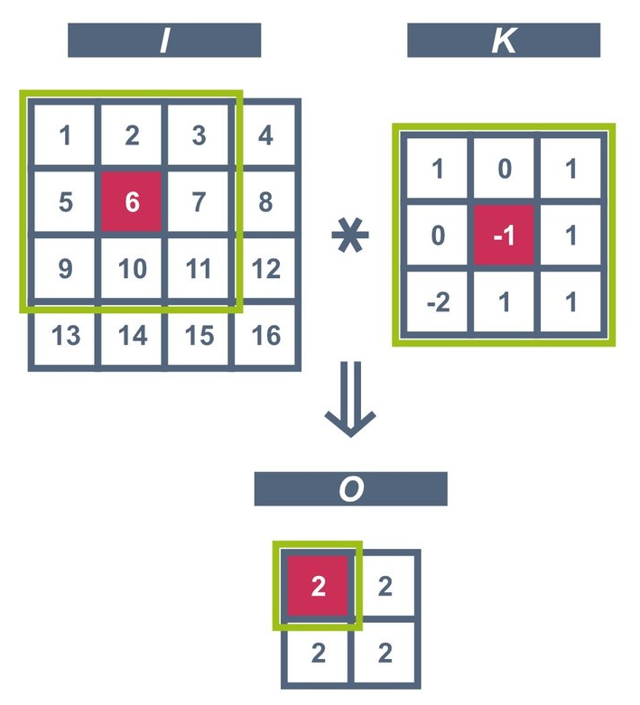
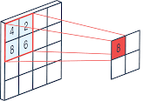
Shape recognition with AI Convolution and MaxPooling
2D Convolution
Max Pooling
A max pooling layer does not have any trainable weights, it acts as an hyperparameter used to reduce the dimensionality after convolutional layers.
The network will learn which convolutional weights need to be applied to extract features.

Slide 15
Shape recognition with AI Classification and Output Layers
In our application, we used fully connected layers with a ReLu activation function, and an output layer called Softmax, which computes the degree of certainty for a sample to belong to a certain class.
________________________________________________________
Layer (type) Output Shape Param #
========================================================
dropout (Dropout) (None, 4, 4, 30) 0
flatten (Flatten) (None, 480) 0
dense (Dense) (None, 500) 240500
dropout (Dropout). (None, 500) 0
dense (Dense). (None, 43) 21543
========================================================
This layer sets some random nodes to 0 to prevent overfitting.
Used to reshape the output of previous layers, taking a unidimensional shape.
Layer of 500 neurons fully connected between each other.
Fully connected layer that computes the likelyhood of the estimation (Softmax).

Slide 16

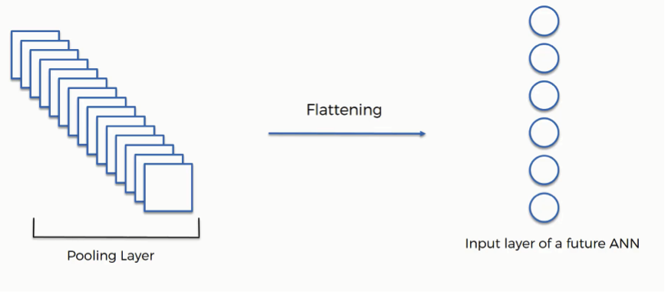

Shape recognition with AI Classification and Output Layers
Dropout
Flatten
SoftMax activation function

Slide 17
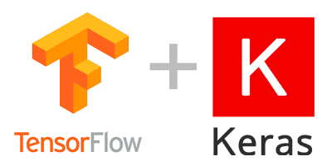

Shape recognition with AI Problems and solutions in ML
Computational power and code complexity
Richness of the database
Keras and TensorFlow allow to easily create and train your networks.
It is very common for machine learning researchers to use public databases available online as a starting point. Furthermore, in the case of having a poor database there are data augmentation techniques to manipulate it and generate a bigger ones.
Another alternative is to reuse models from other researchers, as you can continue training them with your own data to make the process faster.
Google provide powerful computers to scientists so that they can train faster the networks.

Slide 18
Implementation Pseudocode
Training
Testing
Initialization and hyperparameter definition.
Duration of the training
Input and output shape
Data regularization
Preprocess the database if needed.
Split the data into training (60%), testing (20%) and validation (20%)
Define the structure of the model that you want to train
Add input layer
Add convolution layers and MaxPooling.
Add dense layers and dropout
Add an output layer.
Train the model with training and testing sets.
Evaluate your model with the validation data
Initialization.
Import model
Import any dependencies needed
Configure a data input stream.
Preprocess raw data
Send the data to your previously trained network.
Display the resulting prediction.

Slide 19
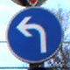


Dataset: GTSRB
What does the dataset contain?
Images cropped to a single traffic sign
Labels file that maps from integer class labels (0,1,2 …) to strings containing their actual meaning (stop, velocity limit …)
All images are grouped depending on their class
How is it structured?
Project
├── MyData
│ ├── 0
│ │ ├── 00000_00000.ppm
│ │ └── GT-00000.csv
│ ├── 41
│ └── 42
└── labels.csv

Slide 20
Activity ROS node that classify traffic signs
Make the necessary ROS code to read images from “/image_raw”, evaluate them and send your prediction.
Practical considerations
TensorFlow requires python 3.X, while ROS works with python 2.7 by default, you can see that the first line of the template script changes the python version to match this requirement.
ROS and TensorFlow image formatting is not the same, you will need to manipulate the ROS message to match them by using the function imgmsg_to_cv2(…)
You can either train a neural network with complete images or used the network previously trained and CV techniques to isolate the traffic signs.

Slide 21
Robot Operating System - ROS
Recognition vs detection

Slide 22
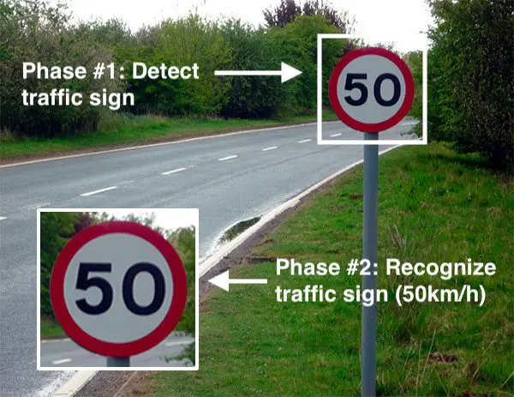
Traffic Sign Detection
So far, we can detect which type. However, in a real-life scenario, we will have a more complex problem due to background noise, and more than one traffic sign in each image. Which requires a higher code complexity

Slide 23
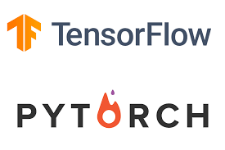

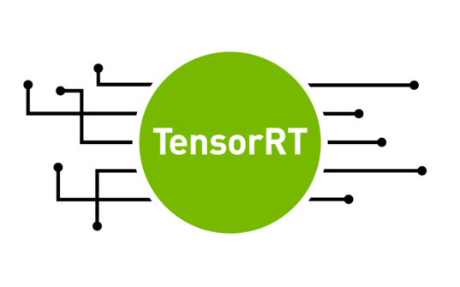
Model formatting
Pytorch/Tensorflow
Native formats of the libraries used to train and deploy AI solutions.
ONNX
Open format built to represent machine learning models
used to share networks between devices and framework
TensorRT
Nvidia’s GPU-only format that optimises the networks for the hardware where it is being deployed
Notes:
https://docs.ultralytics.com/yolov5/tutorials/model_export/#benchmarks

Slide 24
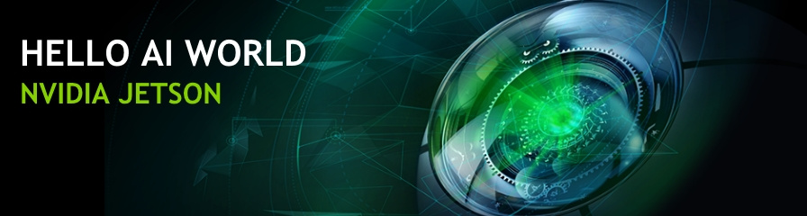
Nvidia Jetson inference
GitHub repository developed by Nvidia with extensive tutorials and documentation regarding the deployment of AI in Jetson platforms.
AI Courses are provided through video tutorials, along with code explanations.
Several off-the-shelf CV models can be found there along with an extensive collection of scripts that can be used to retrain them and deploy them using hardware acceleration.
Notes:
https://github.com/dusty-nv/jetson-inference

Slide 25
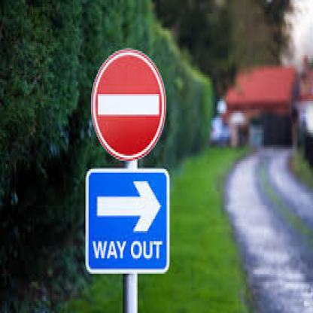
What If the network doesn’t suit our needs?
We have several networks that cover some of the most common problems but are not practical (for example too many classes, not the database we expect to use etc)
Off the shelf
Our case
Network | Classes
SSD-Mobilenet-v2 | 91 (COCO classes)
Detect Net-COCO-Airplane | Airplanes
Up to 39 classes of traffic signs

Slide 26
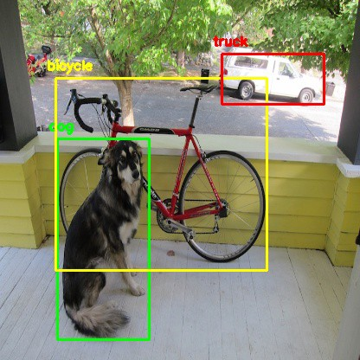
Transfer learning
”In transfer learning, we first train a base network on a base dataset and task, then repurpose the learned features or transfer them to a second target network to be trained on a target dataset and task. This process will tend to work if the features are general, meaning suitable to both base and target tasks, instead of specific to the base task.”
Original training
Custom Database
Adapted network

Slide 27
Activity 2 Using jetson inference
Test one off-the-shelf object detection algorithm following this tutorial.
Implement your own object detection script using the Nvidia libraries following this tutorial.
Add a ROS Wrapper around the object detection algorithm so that it publishes the results into the topic /results.
Note that you need to use camera.Capture() or load the images into the GPU. You can do that by using jetson.utils.cudaMemcpy(img). More information can be found here.

Slide 28
Object detection networks: YOLO
YOLO (You only look once) is a CNN-based object detector, very popular in the literature, you can find the original paper here.
The main issue regarding model selection is that we need a very lightweight implementation, which comes as a tradeoff with smaller accuracy in the prediction.
Extensive documentation and tools to implement your project with YOLO can be found in the ultralitics git hub repo, which has been used as part of the development of this course.
Guidance and good practices when training your yolo instances can be found here

Slide 29
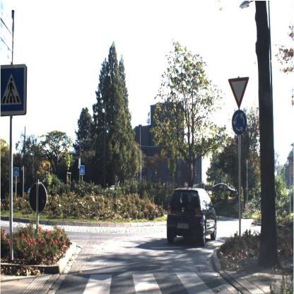
Dataset
Sample.jpg
File structure
├── Database
│ ├── test
│ │ ├── images
│ │ │ ├── sample1.jpg
│ │ │ └── sample2.jpg
│ │ └── labels
│ │ ├── sample1.txt
│ │ └── sample2.txt
│ ├── train
│ │ ├── images
│ │ └── labels
│ └── valid
│ ├── images
│ └── labels
├── data.yaml
└── labels_YOLO_Traffic_Sign.csv
Sample.txt
Class | Xmax | Ymax | Xmin | Ymin
29 | 0.17 | 0.34 | 0.11 | 0.19

Slide 30
Activity 3 Yolo Detection
Following the documentation in the github, run an interference through the command line
Using the functions listed in the template ”A3_template.py” add a wrapper around them to perform shape recognition using the file “models/yolo.pt”
Once your ROS code is working, try it using the models “yolo.engine” and “yolo.onnx” Do you observe any difference in the performance?

Slide 31
Robot Operating System - ROS
AI in edge devices

Slide 32
Design Tips
When using the jetson nano we will need to consider the following limitations related to the capabilities of the device.
We shouldn’t train out networks in the Jetson, as it will take a really long time or it might even fail due to the lack of memory.
We have to keep the models as small as possible to have a reasonable inference time, also the image size needs to be reduced.
We must use CUDA hardware acceleration as it is the main strength of Jetson devices compared with other microcomputers.
Notes:
tradeoff speed vs accuracy
as it is low speed times 1 - 5 frames per second

Slide 33

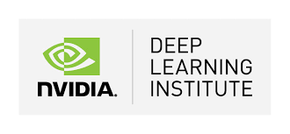

Alternative frameworks and useful tools
ç
Tensorflow for edge devices
Nvidia AI school
Roboflow for database manipulation

Slide 34
Robot Operating System - ROS
AI in ROS

